Slide 1
SENTIMENT ANALYSIS OF RESTAURANT REVIEW
CAPSTONE PROJECT
Presented By: Homi Dhumal
Student Name : Homi Dhumal
College Name & Department : NBN Sinhgad Technical Institutes Campus

Slide 2
OUTLINE
Problem Statement
Technology used
Wow factor
End users
Result
Conclusion
Git-hub Link
Future scope

Slide 3
Problem Statement
Businesses want to know what their customers think. People share their thoughts online, but it's hard to read and understand all of them. Sentiment analysis helps computers understand if people are happy or unhappy in their messages. This helps businesses make their products and services better.

Slide 4
Technology used
Libraries: NumPy, Pandas, Matplotlib, NLTK
Machine Learning Algorithms: Logistic Regression, Decision Tree, Random Forest, K-Nearest Neighbors (KNN), Support Vector Classifier (SVC)
Development Environment: Jupyter Notebook

Slide 5




Wow factors
Accurate results
Accurate classification
Higher accuracy
Flexible
Scalable
Algorithm Benchmarking
Data-Driven Insights
Positive
Review
Model
Negative

Slide 6
End users
Restaurant owners and managers:
They can use the sentiment analysis tool to gain insights into customer feedback and make informed decisions to improve their services, menu offerings, and overall customer experience.
Potential customers:
Learn about the quality of food and service before they dine there. Positive changes in response to feedback contribute to better overall dining experiences.
Market researchers and analysts:
Data analysts and researchers in the restaurant industry can use the sentiment analysis results for deeper insights into customer preferences, trends, and areas of improvement.
Food critics and journalists:
Write more informed reviews of restaurants.

Slide 7
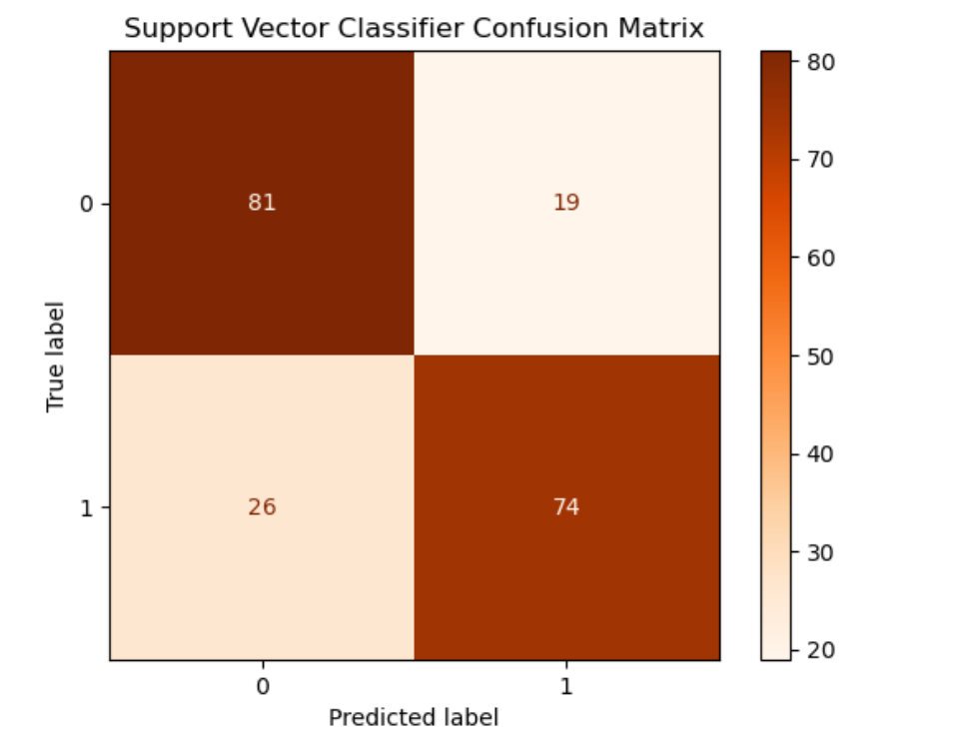
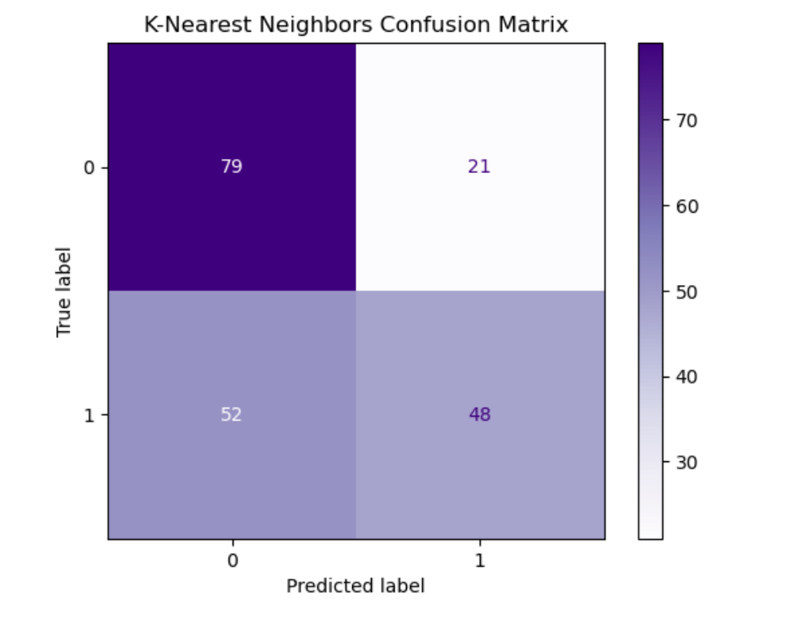
Results
Support Vector Classifier :
K- Nearest Neighbors :
The accuracy score for the model is 77.5%
The precision score for the model is 79.56%
The recall score for the model is 74.0%
The accuracy score for the model is 63.50%
The precision score for the model is 69.57%
The recall score for the model is 48.00%

Slide 8
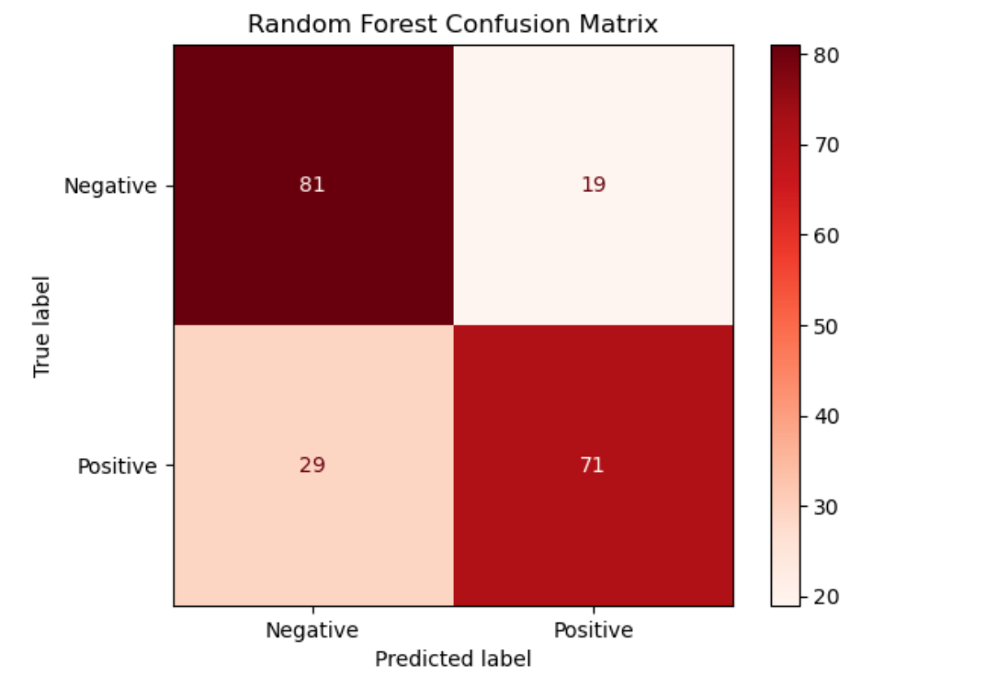
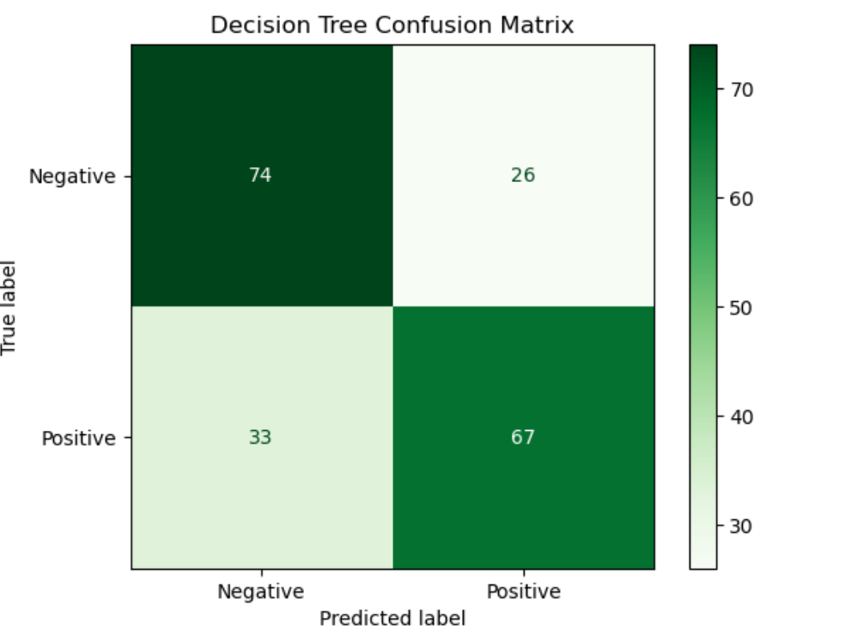
Results
Random Forest Classifier :
Decision Tress Classifier:
The accuracy score for the model is 76.0%
The precision score for the model is 78.89%
The recall score for the model is 71.0%
The accuracy score for the model is 70.5%
The precision score for the model is 72.04%
The recall score for the model is 67.0%

Slide 9
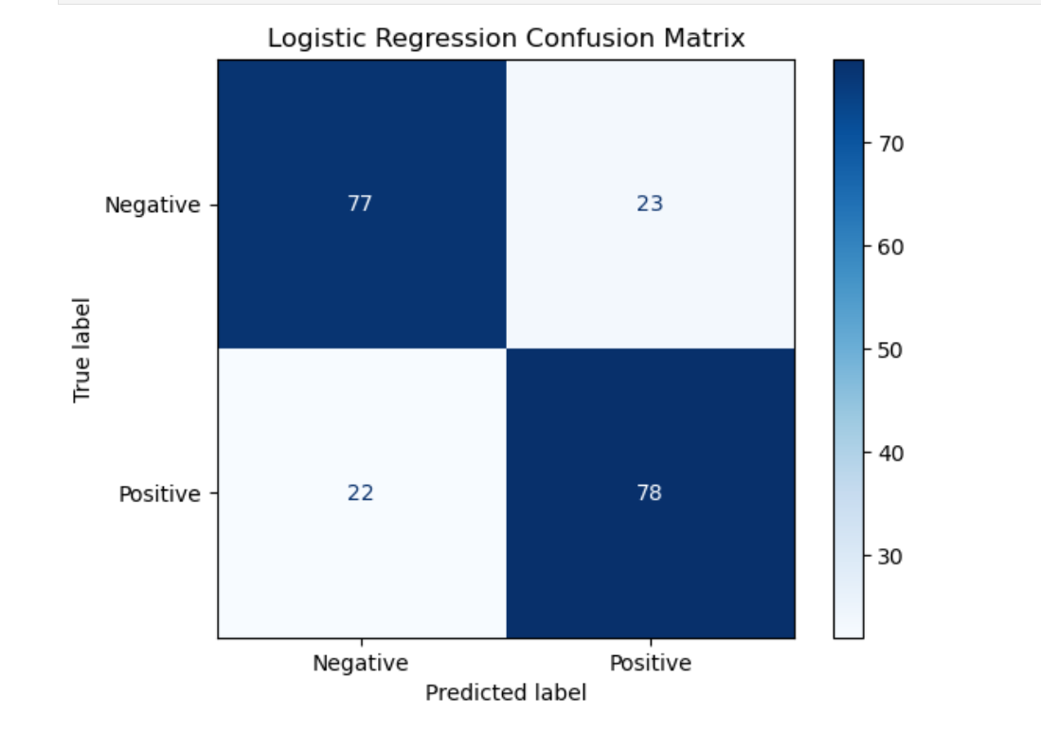
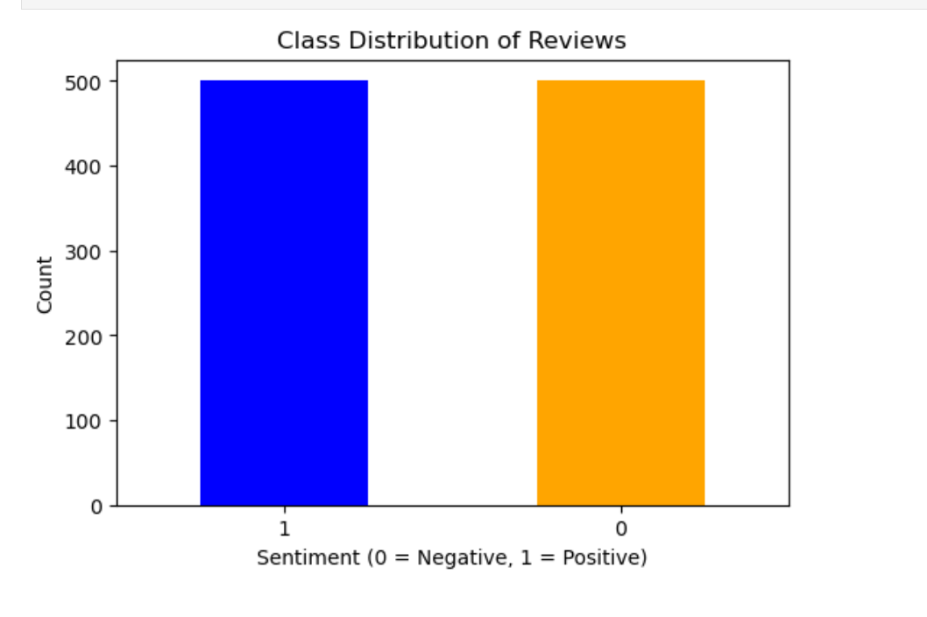
Results
Logistic Regression Classifier :
Class Distribution Review:
The accuracy score for the model is 77.5%
The precision score for the model is 77.23%
The recall score for the model is 78.0%

Slide 10
Conclusion
The sentiment analysis system for restaurant reviews successfully demonstrates how natural language processing and machine learning can turn raw customer feedback into valuable insights. By leveraging advanced algorithms, the system provides restaurant owners, managers, and customers with a deeper understanding of sentiment trends, enabling data-driven decision-making.
Support Vector Classifier Algorithm and Logistic Regression Classifier Algorithm are the best algorithm amongst all the algorithm used for this dataset with the highest accuracy score of 77.5%.KNeighbours Classifier Algorithm is the worst algorithm amongst all the algorithm used for this dataset with the lowest accuracy score of 63.50%.
This project showcases the potential to enhance customer experience, improve service quality, and streamline management processes. As restaurants continuously evolve, this solution can be further scaled and customized to meet diverse business needs, offering long-term value in a competitive market.

Slide 11



GitHub Link
https://github.com/imhomi/SENTIMENT-ANALYSIS
https://drive.google.com/file/d/156RpyxBkHfv3AuYi0xBbh50a1ygmQ7qe/view?usp=sharing

Slide 12
Future scope
Enhanced Accuracy with Deep Learning
Multi-Language Support
Real-Time Analysis and Alerts
Advanced Sentiment Categorization
Integration with Social Media
Personalized Customer Recommendations

Slide 13
THANK YOU

